Slide 2
Unit 1: Programming Languages And Problem Solving (6hrs)
Programming Languages (machine-level language, assembly language, and high-level language) and its generations.
Software and its types
Structured programming
Problem-solving using computer - Problems Analysis (understanding of the problem, feasibility, and requirement analysis), Design (Algorithm and flowchart), Coding (compilation/interpretation and execution), Testing and debugging, Implementation, Evaluation, and Maintenance of computer programs, Program documentation

Slide 3
Program Development Life Cycle
A correct program can be written with the proper planning and its implementation.
It is easy to write programs for simple problems.
But it is very difficult to develop programs for complex problems.
So, programmers develop the program in a planned manner to master the complexity of the problem.
They follow a series of steps involved in the program development process collectively known as the Program Development Cycle (PDC).

Slide 4
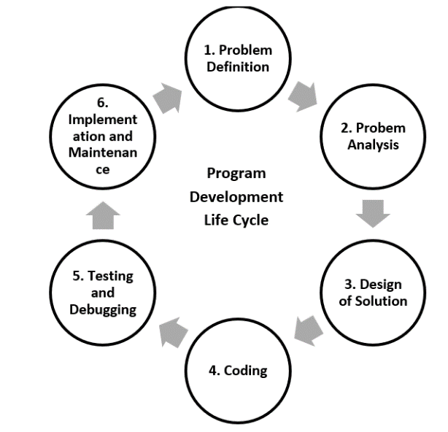
PDLC
PDLC is a systematic way of developing quality software.
It provides an organized plan for breaking down the task of program development into manageable chunks,
each of which must be successfully completed before moving on to the next phase

Slide 5
1. Problem Definition
This is the first phase where we define the problem statement and decide the boundaries of the problem.
In this phase, we need to understand
what is the problem statement,
what are our requirements and
what is the output of the problem solution?
All these are included in the first phase of the program development life cycle

Slide 6
2. Problem Analysis
This is the process of eliciting (finding, drawing, extracting), documenting, analyzing, validating, and monitoring requirements.
Here, we determine the requirements like variables, functions, etc. to solve the problem.
It means that we gather the required resources to solve the problem, defined in the problem definition phase.

Slide 7
2. Problem Analysis
Feasibility Study: Evaluating if the problem can be solved with the available resources (time, technology, budget). It considers technical, operational, and economic factors to determine the practicality of the project.
Requirement Analysis: Gathering specific requirements that the solution must meet. This might involve meeting with stakeholders, creating a requirements document, and defining constraints or limitations.

Slide 8
3. Design
This is the process of developing a plan or blueprint to solve the problem identified in the problem analysis phase.
We break down the requirements and outline the structure of the solution, including system architecture, data flow, and functionality.
Specify how each component will interact, set up the algorithms, and decide on the specific methods and logic to be implement.

Slide 9
4. Program Coding
Coding can be done in high-level language and low-level language.
We write programs to solve the problem using programming languages like C, C++, Java, etc.
Coding requires knowledge of programming syntax, data structures, and logical thinking.

Slide 10
4. Program Coding
Compilation: In languages like C and Java, code is compiled, which translates the entire code into machine language before execution.
Interpretation: In languages like Python and JavaScript, code is interpreted line-by-line during execution, allowing for quicker testing but slower performance.

Slide 11
5. Testing and Debugging
Debugging and testing are mutual tasks.
This is the process of detecting and removing errors in the program so that the programmer produces designed results on all occasions.
Types of error: Syntax error, Runtime error, Logical error, Late-End error.
Debugging is isolating and correcting any type of error.

Slide 12
6. Implementation and Maintenance
The developed program is implemented.
However, the software solved, go for maintenance due to technological change, client desire, and political environment.
Training and Support: Users and stakeholders may need training or documentation to understand how to use the new software effectively.

Slide 13
6. Implementation and Maintenance
Evaluation: Reviewing the program’s effectiveness and efficiency after implementation. This might include gathering user feedback, measuring performance, and comparing the solution against the initial requirements.
Maintenance: Regular updates and maintenance are essential to keep the software functioning over time.

Slide 14
7. Documentation
Program documentation starts from the start of the Software Development Life Cycle (SDLC).
It keeps most of the information of all phases while developing projects.
Documentation is used for future reference for both the original programmer and the beginner.

Slide 15
Program Development Tools
Tools that are used to provide roadmap for programming.
Algorithm
Flowchart
Pseudocode

Slide 16
1. Algorithm
An algorithm is a finite set of instructions written in a sequence that should be followed to solve a given problem.
The characteristics of the algorithm are:
Inputs should be externally supplied for processing.
Must produce at least one quantity as output.
Each instruction in the algorithm must be clear.
Should terminate after a finite number of steps.
Must be effective and implementable.

Slide 17
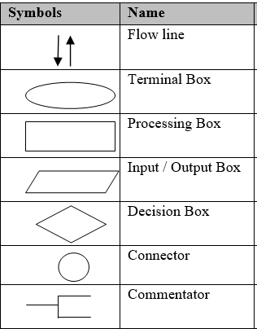
2. Flowchart
is a diagrammatic representation of the procedures for solving a problem.
Simply, it is a graphical representation of the algorithm.
It consists of a set of symbols for different functions which help a programmer to solve a given problem.

Slide 18
3. Pseudocode
A false coding irrespective of any programming language.
Pseudocode is an informal way of programming description that does not require any strict programming language syntax or underlying technology considerations.
It is used for creating an outline or a rough draft of a program.

Slide 19
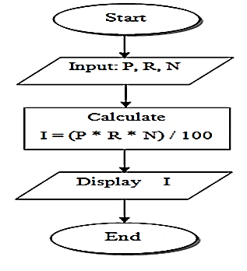
1. Write an algorithm and draw a flowchart to find out the simple interest. Also write the pseudocode.
Flowchart:
Algorithm:
Start
Take inputs Principal, Rate, and No of years (i.e., P, R, N)
Calculate interest (I)
Display Interest
Stop
Pseudocode:
Declare P, R, N, I
Display “Input principal, rate and no of years”
Input (P, R, N)
I= P*R*N / 100
Display (“Interest is”, I)

Slide 20
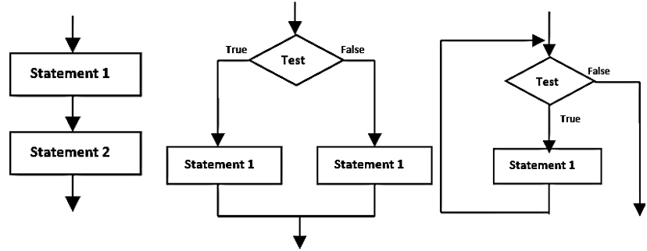
2.4 Flowchart Structures
a) Sequential Structure b) Conditional Structure c) Loop Structure

Slide 21
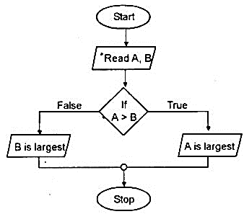
2. Write an algorithm and draw a flowchart to find the largest among two numbers.
Algorithm:
Start
Input A and B
Check: Is A>B?
Yes: Print “A is greatest”
No: Print “B is greatest”
Stop

Slide 22
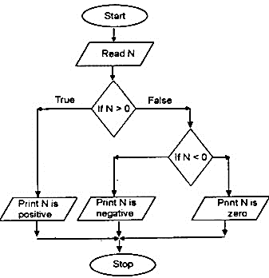
3. Write an algorithm and draw a flowchart to input a number and check if it is positive, negative or zero.
Algorithm:
Start
Input N
Check: Is N>0?
Yes: Print “N is positive” and go to step 5
No: go to step 4
Check: Is N<0?
Yes: Print “N is Negative” and go to step 5
No: Print “N is a Zero” and go to step 5
End

Slide 23
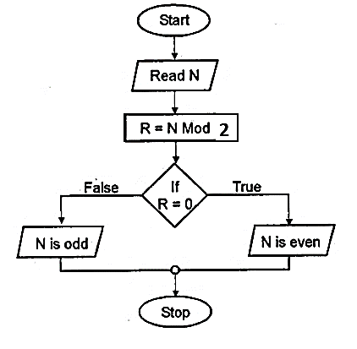
4. Write an algorithm and draw a flowchart to input a number and check if it is odd or even.
Algorithm:
Start
Input N
Check: Is N%2==0?
Yes: Print “EVEN”
No: Print “ODD”
End

Slide 24
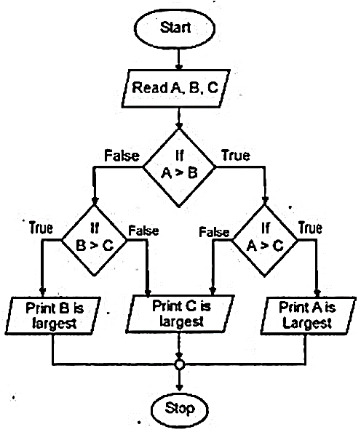
5. Write an algorithm and draw a flowchart to find the largest among three entered numbers.
Algorithm:
Start
Input A, B,C
Check: Is A>B?
Yes: go to step 4
No: go to step 5
Check: Is A>C?
Yes: Print “ A greatest” and goto step 6
No: Print “C greatest” and goto step 6
Check: Is B>C?
Yes: Print “ B greatest” and goto step 6
No: Print “C greatest” and goto step 6
Stop

Slide 25
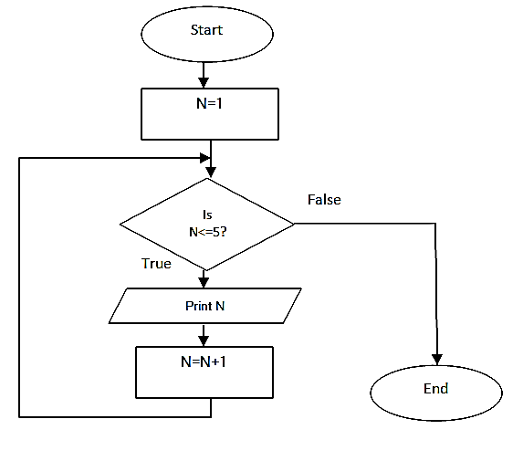
6. Write an algorithm and draw a flowchart to display the number from 1 to 5
Algorithm:
Start
Initialize N=1
Check: Is N<=5?
Yes: go to step 4
No: go to step 6
Print N
N=N+1 and go to step 3
End

Slide 26
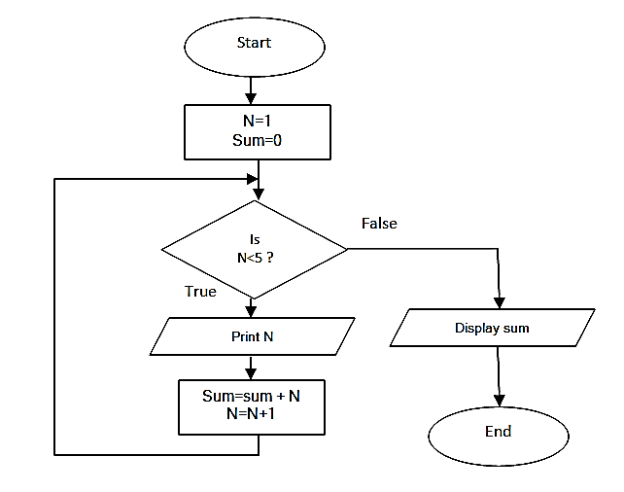
7. Write an algorithm and draw a flowchart to display first four natural numbers, and also their sum.
Algorithm:
Start
Initialize N=1, Sum=0
Check: Is N<5?
Yes: go to step 4
No: go to step 7
Print N
Sum = Sum + N
N=N+1 and go to step 3
Display Sum
End

Slide 27
Assignment
Write an algorithm and draw a flowchart
to find the smallest among three entered numbers.
to find the middle among three entered numbers.
to enter a number and display it in reverse order.
to print all the prime numbers up to 50.
to print the factorial of an input number.
to read the marks of three different subjects and display the total marks. The program should allow entering the marks of other students if the user presses the ‘Y’ key.
to read a positive number (integer) and compute as below:
If the number is even, half it and print the result.
If the number is odd, multiply by 3 and add 1 and print the result.

Slide 28
End of Lecture 4

Slide 29
Introduction to C

